Slide 1
Course and contest Full Name
Advanced VLSI Design (Module 24151)

Slide 2
Aim of the course
Developing skills to design VLSI systems
Design and simulation of VHDL
Synthesis for FPGA and ASIC
Layout of a final chip
Developing soft skills
Team work
Presenting your work and ideas
Motivation: Best results will be awarded

Slide 3
Facts to present 1/3
Design and architecture:
Figures to be given to describe your transformation design:
Chosen adders, multipliers
Algorithmic/architectual/component enhancements
Optimizations
Explain WHY they were chosen!
Explain WHY something you tried did not work well (we want you to understand and analyze!)
Pure try and error is a bad explanation!
What did you expect?
What does theory promise?

Slide 4
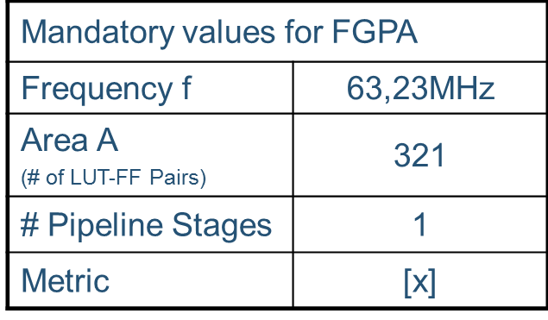
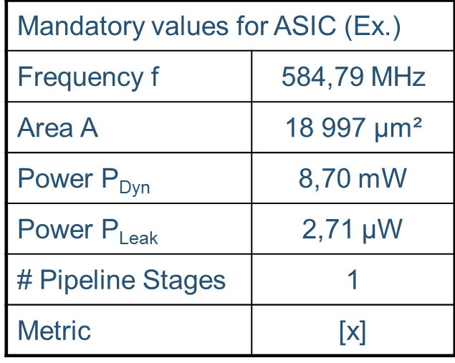
Facts to present 2/3
Figures to be given (with units):
Frequency response
Pipeline depth
Area
Power
All other important facts you consider important (e.g. # of logic blocks, registers …)

Slide 5
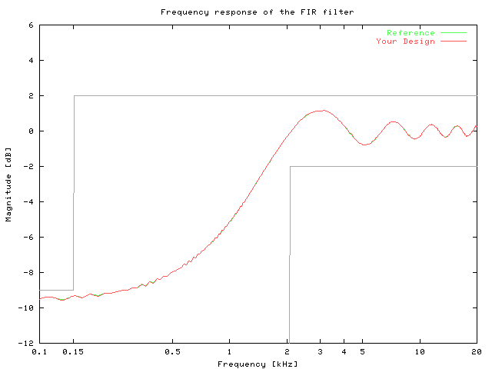
Facts to present 3/3

Slide 6
Flow for the presentation
Recommended flow for reasoning:
Observations: What do/did you observe in your design?
Problems, drawbacks, potential enhancements …
Do your observations leave room for optimizations?
What do you expect to change?
What does theory promise?
Present and discuss results of the implemented optimizations
Conclude based on your results (e.g. approach was reasonable, unsuccessful)
Outlook on next steps/optimizations
Is there room for further optimization? Why? What do you plan to do?

